Slide 1
Advanced GUI
Università di Modena e Reggio Emilia
Prof. Nicola Bicocchi (nicola.bicocchi@unimore.it)

Slide 2
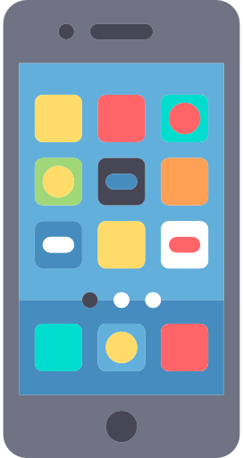
Issue
Suppose our application after getting records from a data source has to show them.
A simple TextView could go, but if we retrieve 100 or 1000 records from a Database, how much time is needed to load inside of it?
Also, if we load all data at the same time, it will impact app performance and use lot of resources.
We can not know in advanced how many data will be loaded
Data Source
?
Bob
getData()
Alice
{“Bob”,”Alice”,”Elen”}
Elen
Show Data
Show Data

Slide 3
Adapters & AdapterViews
Android Adapters are “a bridge between an AdapterView and the underlying data for that view”.
AdapterView: is a group of widgets (aka view) components in Android that include the ListView, Spinner, and GridView. In general, it is the widgets that provide the ability to select in the UI. AdapterView is responsible for how data should be displayed. Adapter Views controls and display View objects repeatedly. It contains a set of Views that display data from data source
Adapter: is responsible to managing the data, It reads data from various data sources, coverts it into View objects and provide it to the linked Adapter view to create UI components.
Data Source
Adapter
Bob
Alice
Elen

Slide 4
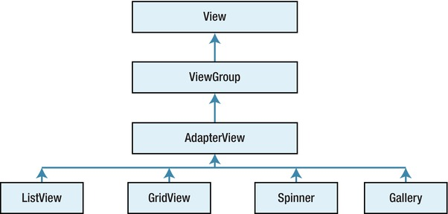
AdapterViews

Slide 5

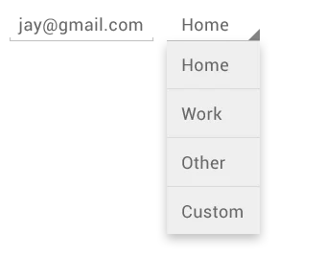

AdapterViews: Type
ListView: It displays a vertically-scrollable collection of views, where each view is positioned immediately below the previous view in the list.
Spinners: provide a quick way to select one value from a set of values. Touching the spinner displays a dropdown menu with all other available values, from which the user can select a new one.
GridView: is a ViewGroup that displays items in a two-dimensional, scrollable grid.

Slide 6
Adapter: Type
ArrayAdapter: takes data from the array creates a view out of it that we can use
SimpleCursorAdapter: takes the data from a cursor and creates a view out of it that we can use. Cursor is Android object that represents data taken from database
BaseAdapter: custom adapter definable and customized in terms of: how data should be tracked, how data should be processed, how views should be generated and so on.

